Slide 1
^{DSI Capstone} ^{10/10 Weekly Update}
Oct 13, 2022

Slide 2
Agenda
1
From Last Week
2
Modeling Preparation
3
Proposed Modeling Methods
4
Next Steps

Slide 3
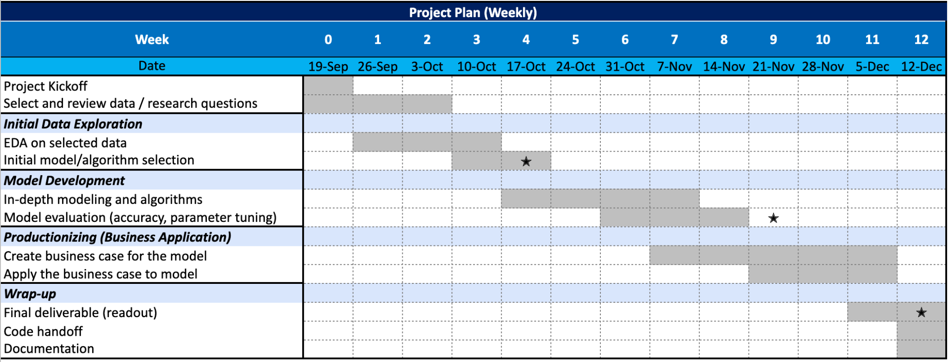
From Last Week: Timeline
1
1st progress report

Slide 4
From Last Week
1
Action items:
Data pre-processing for modeling: quantify metrics identified from EDA
Searching for potential models/algorithms
Start building quantitative objective functions for optimization

Slide 5
Proposed Optimization Considerations
2
Research Question: find optimal locations to distribute EV charging stations in Washington state, focusing along the highways?
Objective function
Maximize covered traffic count
Variables
locations of potential EV charging stations
crime rate by population (total crime/population)
population by census tract
natural risk index adjusted by population
distance from highway exits
distance between closest existing EV charging stations
tourist attractions/entertainments
distance to highway exit < 1 miles
distance between EV charging stations < 50 miles
# of EV charging stations within 20 mile distance < X¹
risk index < X
crime rate < X
# of EV charging stations per 1k people < X
Constraints
(still deciding)
1. X are hyperparameters we will fine-tune during modeling
Objective function: maximize covered traffic count
Variables
traffic count (max/avg within 5 miles /10 miles)
crime rate by population (total crime/population)
population by census tract
natural risk index adjusted by population
distance from highway exits
distance between closest existing EV charging stations
tourist attractions/entertainments (within 1 miles / 5 miles)
Constraints (still deciding)
distance to highway exit < 1 miles
distance between EV charging stations < 50 miles
# of chargers within 20 mile distance < X
risk index < X
crime rate < X
Notes:
Variables consider # of chargers(>= level 2) within range 20 mile?

Slide 6
Data Preprocessing: combined data together for modeling use
2
Data entry:
gas stations
name
latitude
longitude
1. Traffic
2. Highway exits
Average traffic counts within 5 miles / 10 miles of driving distance
Max traffic counts within 5 miles / 10 miles of driving distance
Route distance to closest highway exit (only available for locations within 5-mile width of highway corridor)
3. EV chargers
4. Attractions
1 data file
Distance to closest EV station
# of EV stations within 2 miles, 5 miles, 10 miles, 20 miles, 50 miles of driving distance
Attraction counts within 1 mile / 5 miles of driving distance
Closest attraction to each gas station and its distance
5. Crime
6. Natural risk index
Total crime count in the county where the gas station is located
Risk index in the county where the gas station is located

Slide 7
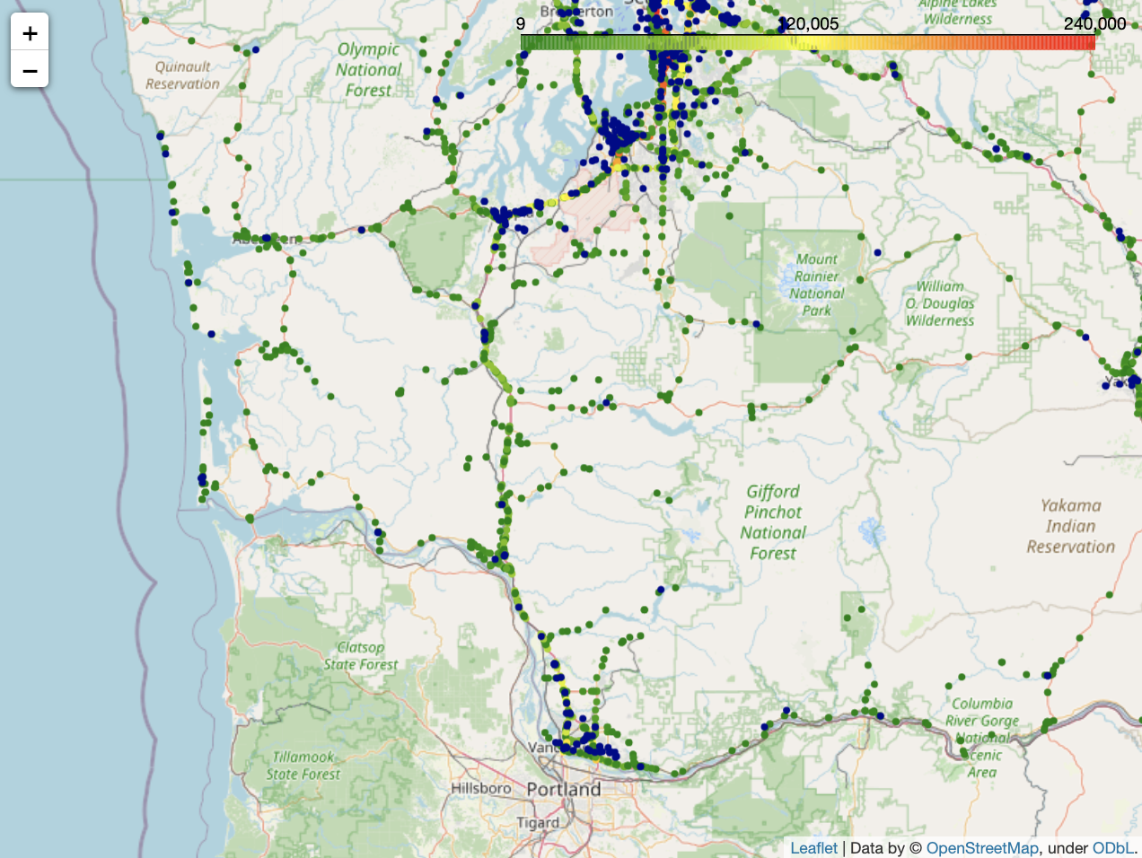
Optimization
Initial Modeling area focuses on I-5 Route (Olympia - Vancouver), then expand to other highways
3
: EV charging stations
: annual average daily traffic
I-5

Slide 8
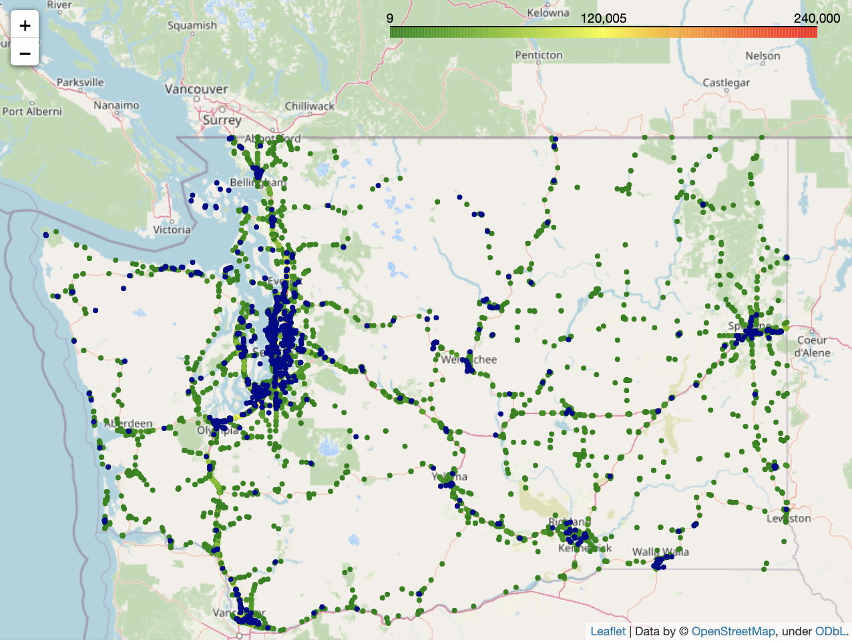
Advanced Modeling: Transfer Learning
3
: EV charging stations
: annual average daily traffic
~1% of total annual average daily traffic (AADT)
Approximate total AADT in circled area: 1,716,549
~3% of total annual average daily traffic (AADT)
Approximate total AADT in circled area: 5,069,390
~4% of total annual average daily traffic
Approximate total AADT in circled area: 6,243,820
Notes:
Transfer learning (TL) is a research problem in machine learning (ML) that focuses on storing knowledge gained while solving one problem and applying it to a different but related problem. For example, knowledge gained while learning to recognize cars could apply when trying to recognize trucks.

Slide 9
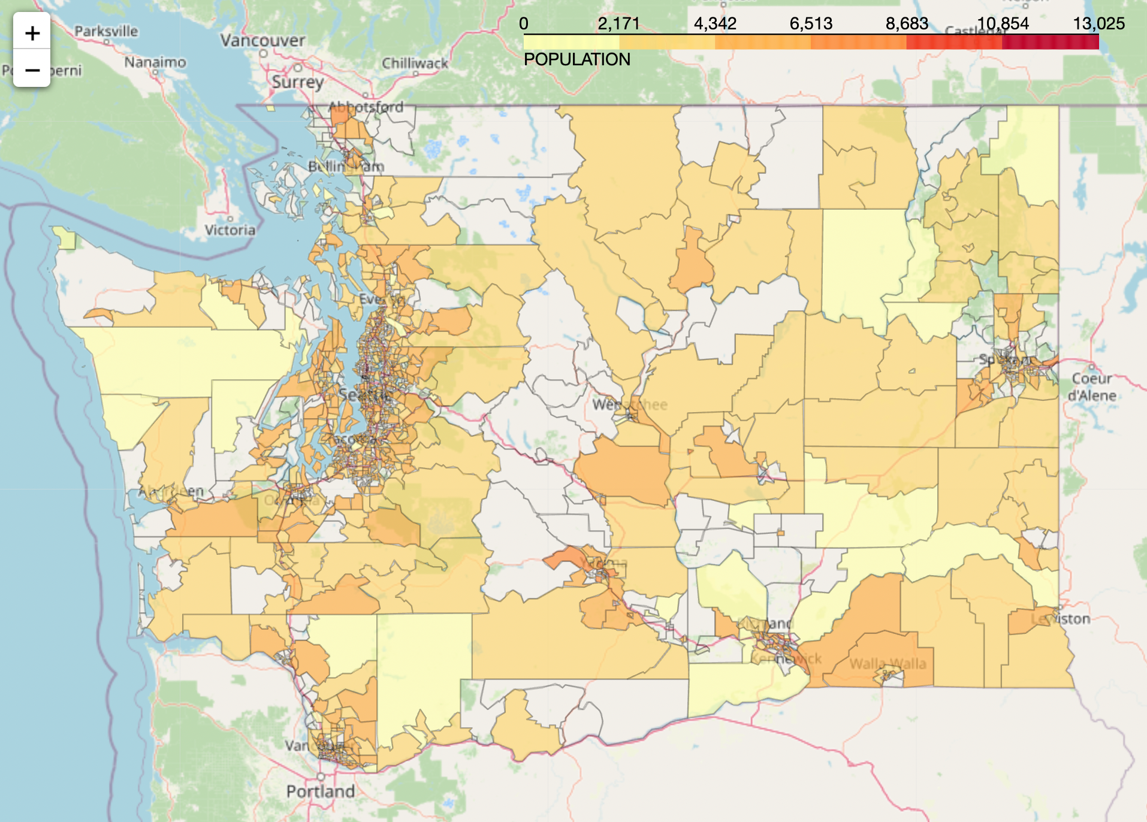
Advanced Modeling: Transfer Learning
3
Test set:
The census tracts where we are interested in.
Training set:
Census tracts in urban area. We will assume these are fully developed area.
Data will be group by each census tract. Each census tract will then be assigned to training set, validation set, and test set. (criteria TBD)
The ground truth and output will be the optimal number of EV chargers/stations in the specific census tract area.
Validation set:
Those in suburban/rural area but with relatively saturated number of EV charging stations. We assume these are the baseline results.

Slide 10
Modeling Difficulties
3
The problem is supervised learning but with optimistic assumptions. It is hard to evaluate the performance of the model
How to define criteria to fairly assigned census tracts to training, validation, testing set
Typical ML problems: Garbage in garbage out
The model results can be a reference for optimization, as it ideally will give us the number of each census tract where we proposed/are interested in.

Slide 11
Next Steps
4
Action items:
First progress report due next week
Optimization: build optimization model with defined objective function and constraints for selected area
Transfer learning: define criteria to fairly assigned census tracts to training, validation, testing set
Notes:
Ask midpoint readout for next week?

Slide 12
Appendix

